Slide 1

Flash Review

Slide 2


Innovation Contest – Where are we?
Idea selection
Ideation Sessions
Submit an idea!
Build a team
Make it real!

Slide 3

Agenda
Innovation Contest – 3 min
Ideas: Flash Review – 20 min
Let’s go for speed!

Slide 4
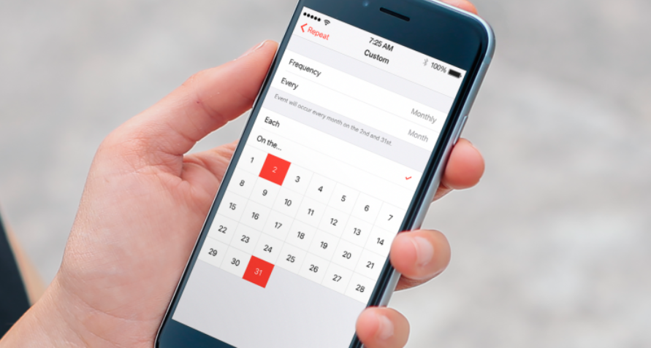
Just wanna do the same!

Slide 5
Just wanna do the same!
@Severine & @Muthu
The team
Problem
Idea
Delivery

Slide 6

Tailor your flow

Slide 7
Tailor your flow
@Stephen
The team
Problem
Idea
Delivery

Slide 8


Progressive Web App
Shrey, Julien and Jean
Flash Review
Digital Speed Innovation Contest
Notes:
Hello, I am Shrey Rupani working in RefX from Bangalore and I going to talk about the mobile web and how to make it better

Slide 9





The problem
Is it worth installing the app?
Notes:
When customers want to access airline services, they are given the choice between the web and the app.
And they are going to go one way or the other depending on criteria.
Web apps have reach, but native apps have capabilities such as...

Slide 10
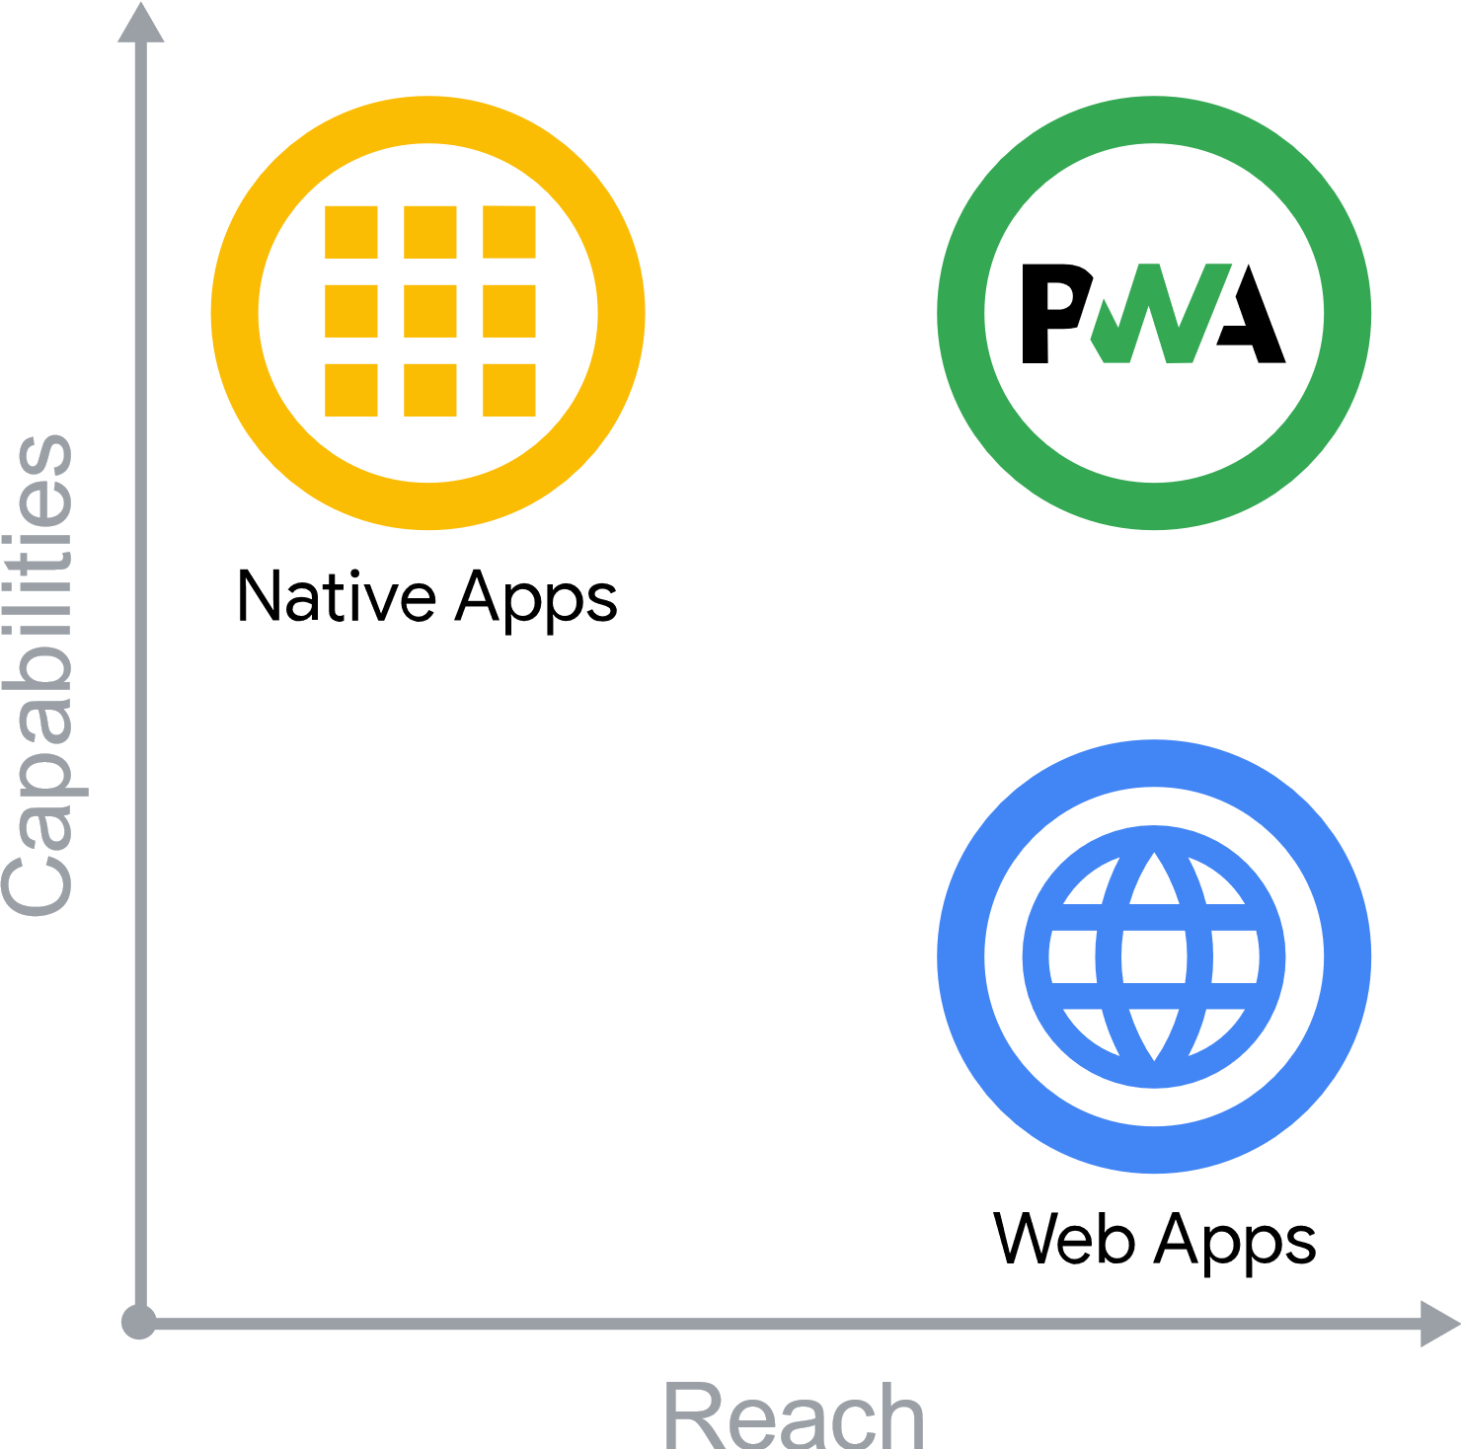
Idea
Highly performant Reference Experience
Skip app store step to install airline app
Evergreen app and web
Offline support
Single code base
Standalone experience
Notes:
Progressive Web Apps (PWA) are built and enhanced with modern APIs to deliver native-like capabilities, reliability, and installability while reaching anyone, anywhere, on any device with a single codebase.

Slide 11
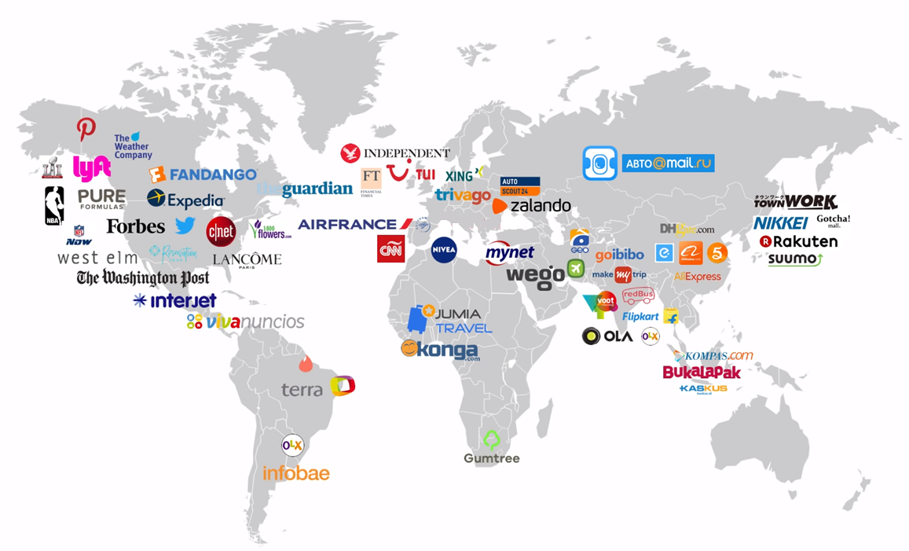

PWA in the world
Reference Experience
Notes:
So as you can see, PWA is booming worldwide and Amadeus is part of this move with Reference experience
Native Apps and PWA are still going to coexist for few years and we definitely need to adopt PWA technology as the traditional web will disappear progressively

Slide 12
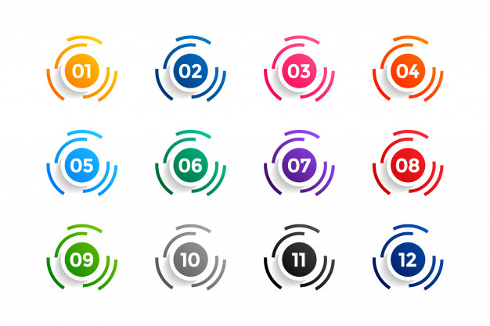
Delivery
Installable PWA with prompt
Statics loaded by service worker
Splash screen
Determine perceived user response time
Notes:
I think the committed scope is to:
Create a manifest file for bookmark
Splash screen
Start using the service worker to fetch all of the statics.
Determine the perceived response time for the user.
And if possible, I'll try to add offline support by:
Adding a continuous banner when the network is not there.
Allow the user to continue the cart order offline(browser only).
When internet is available, a push notification is sent.
The browser cart is pushed to the server and then the payment is made normally.

Slide 13

Supersonic Subatomic Pelican

Slide 14
Just wanna do the same!
@Fabrice
The team
Problem
Idea
Delivery

Slide 15

Improve Interaction Speed
Notes:
Move redux logic into Javascript Workers

Slide 16
Improve Interaction Speed
The team
Stefan Seeger
The problem
All Javascript applications are running the code in the one main thread. This means that big data computations are blocking UI interactions.
The idea
Move the data heavy ngrx-reducers into WebWorkers to parallelize them
Delivery
PoC on RefX Availability to assess the time to interaction gains
Risks

Slide 17
Let’s go for speed! Demo Fri the 13th

Slide 18
Warm-up!

Slide 19

Notes:
In 10 min, list as many ideas as possible to make these AT-ATs quicker.

Slide 20
Some rules
Be positive & constructive Comment to build on ideas, not highlighting flaws Use “Yes and” instead of “No, but…”!
It’s too early to assess technical difficulty Don’t block yourself thinking about ideas you find too hard to implement
Let people speak, one discussion at a time
There is no silly idea! Say whatever goes through your mind

Slide 21
Problems Finding

Slide 22

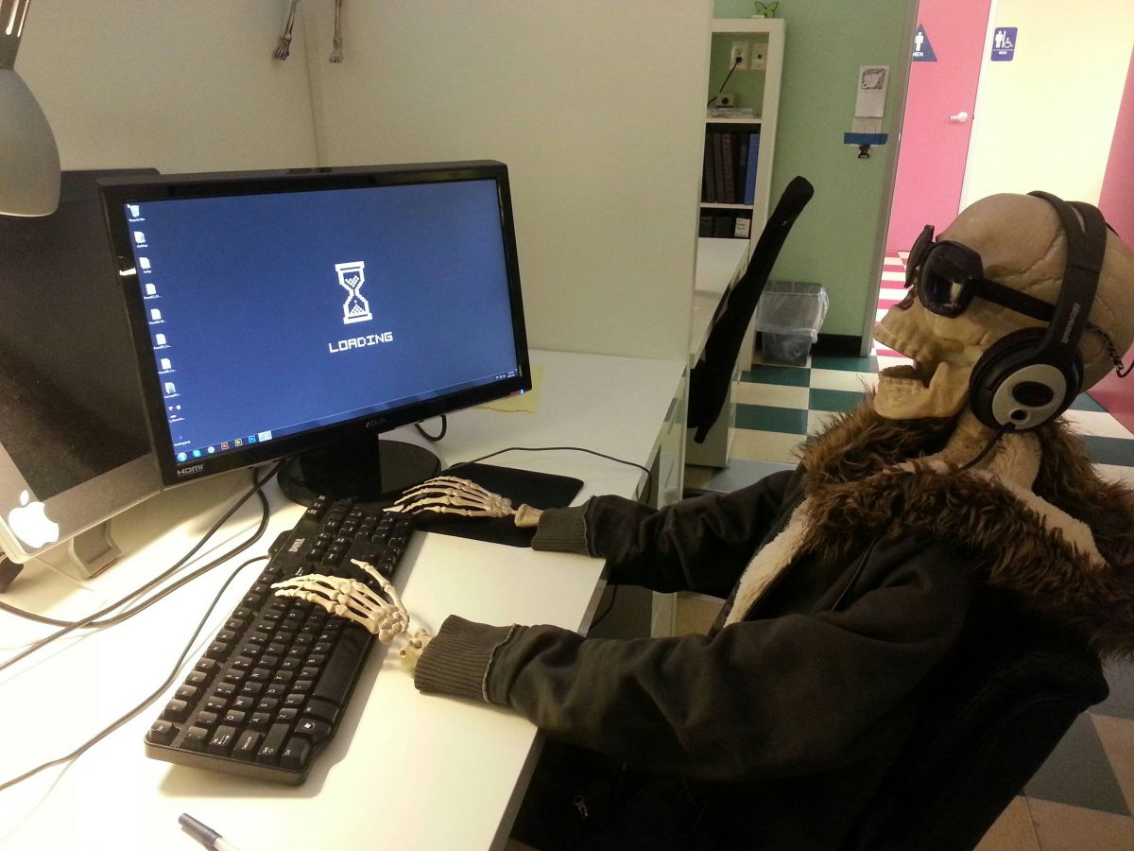
15’
List :
Problems you faced as a user in slow or too complex interfaces
Problems of slowness you know we have in our interfaces

Slide 23

Notes:
Think about elderly, disabled people.
What does it mean for them to make the applications/interfaces quicker?

Slide 24
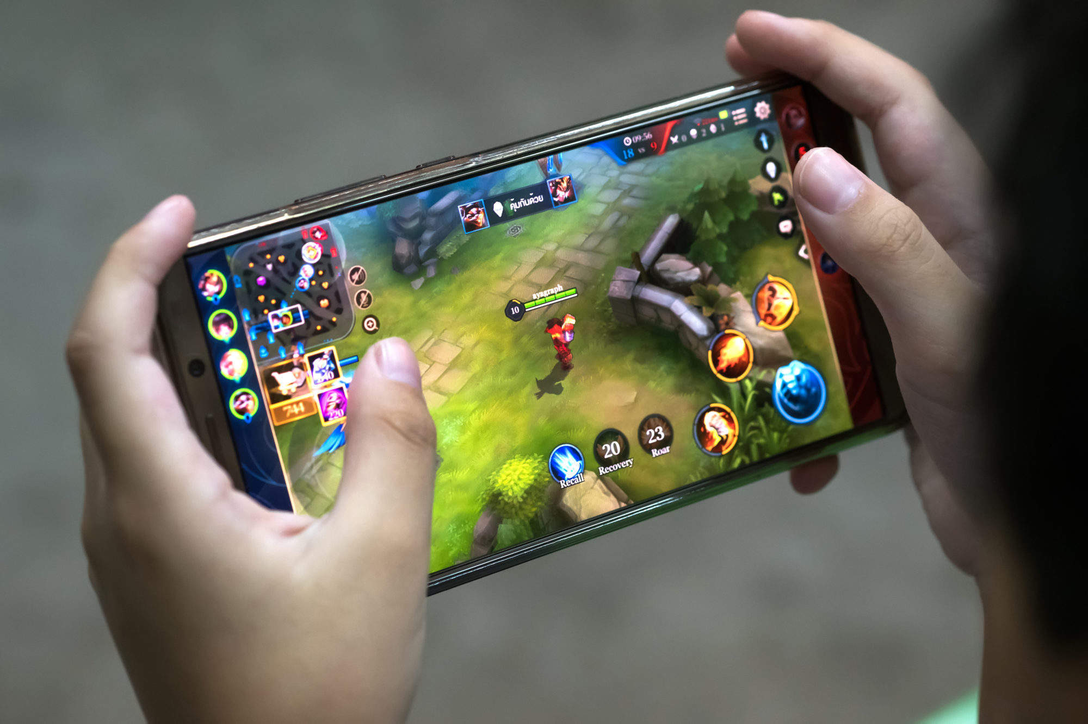
Notes:
Think about industries where response time is key. How did they manage to reach their objectives? Anything we could re-use?

Slide 25

Notes:
What would mean having quicker interfaces for this user? How would we help him achieve his goal?

Slide 26
Problems Consolidation
30’

Slide 27
Problems Selection
10’

Slide 28
Wrap-up and next steps

